Slide 1
PCOD DATASET ANALYSIS
MOULIKA KOLAVASI

Slide 2
INTRODUCTION
Polycystic ovary syndrome (PCOS) is one of the most common yet underdiagnosed hormonal disorders in women, often affecting overall health, fertility, and quality of life.
Early detection is crucial, but symptoms are often overlooked or misunderstood. By analyzing real-world health data, this project aims to uncover hidden patterns and risk factors that could support early diagnosis and better awareness.
With the growing focus on women’s health, using data analytics to explore PCOS is both relevant and impactful.
TERMS USED IN THIS PROJECT FOR REFERENCE
BMI – Body Mass Index, used to assess body fat based on height and weight.
LH – Luteinizing Hormone, triggers ovulation.
FSH – Follicle-Stimulating Hormone, helps regulate the menstrual cycle.
PRL – Prolactin, controls milk production and affects fertility.
TSH – Thyroid-Stimulating Hormone, regulates thyroid function and metabolism.

Slide 3
Objectives
Analyze patterns and correlations in PCOS-related health data
Understand the impact of clinical factors on PCOS diagnosis
Tools used: Excel and Power Query

Slide 4
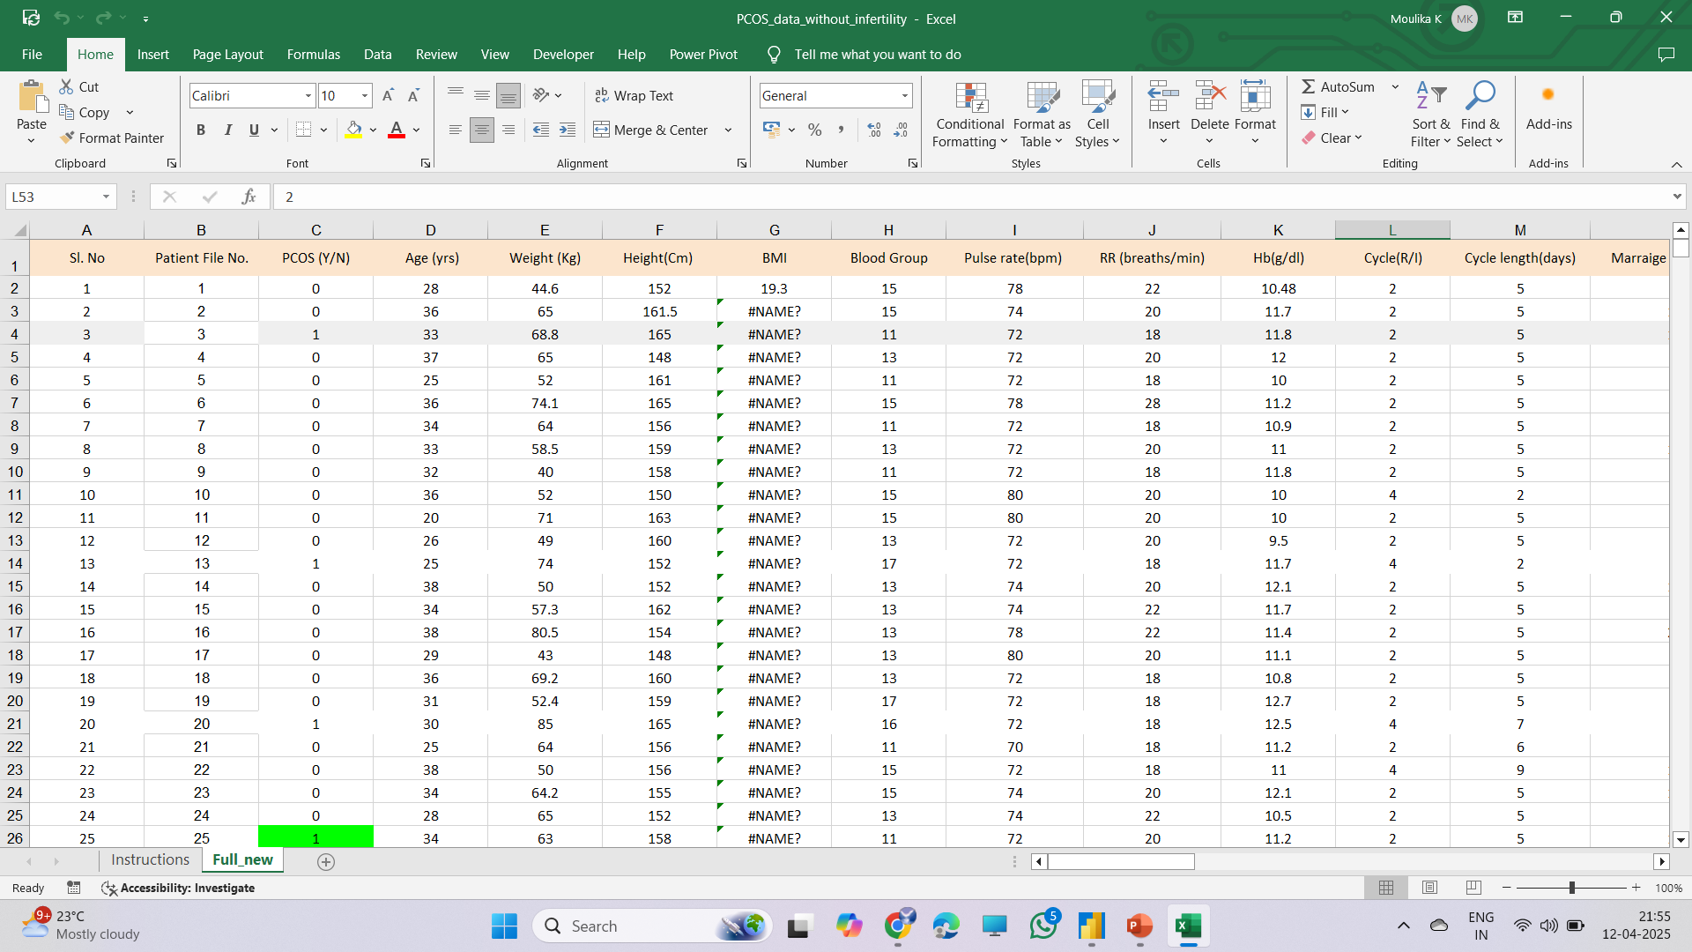
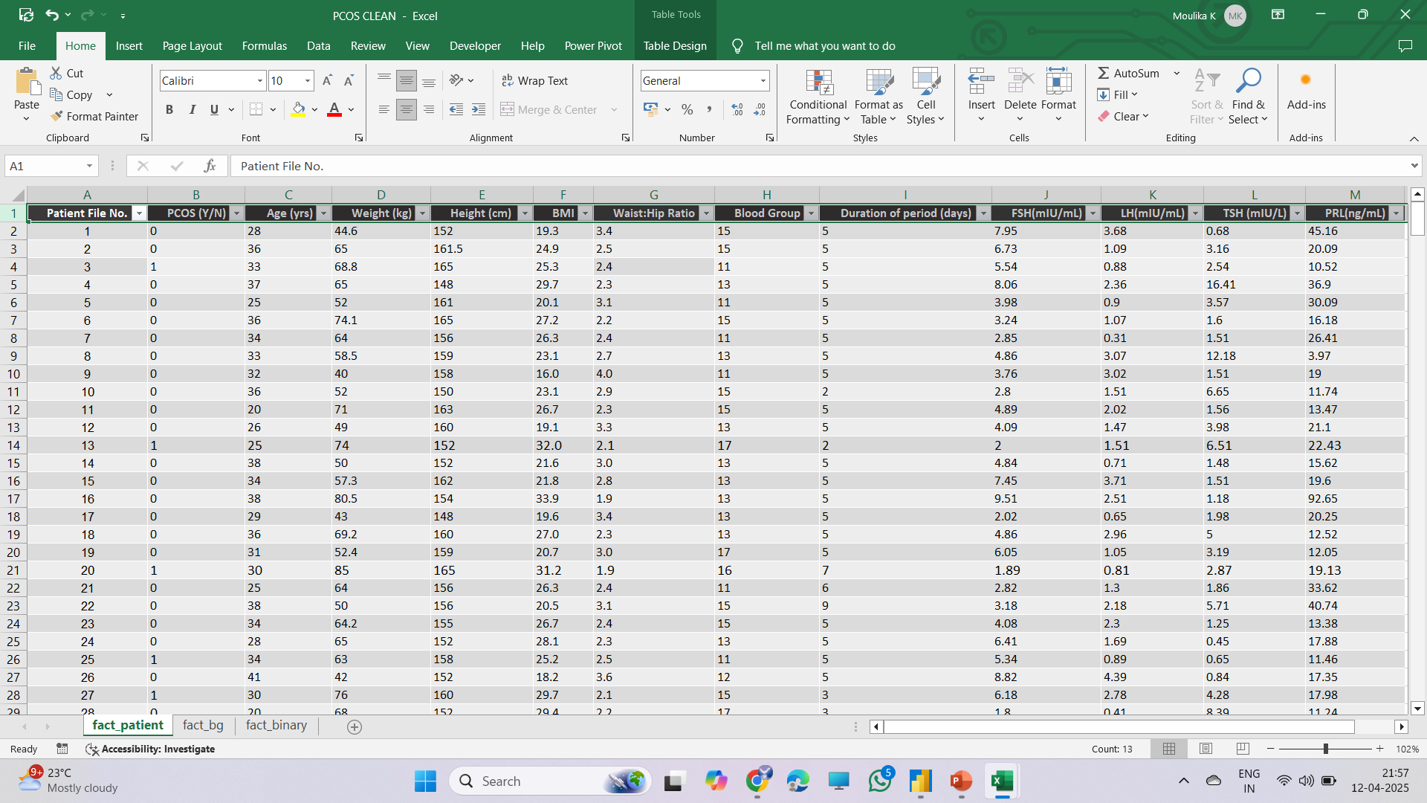
RAW Vs CLEANED DATA TABLES
Issues
Null data points
Inconsistencies
Extra columns
Rectified
Nulls removed
Column names standardized
Irrelevant data dropped

Slide 5
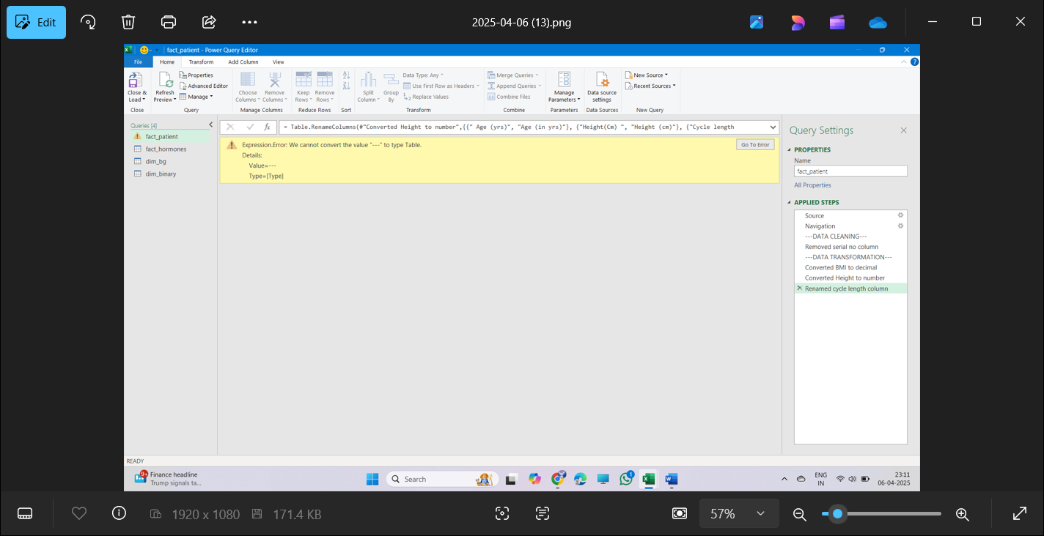
ETL (Extract, Transform, Load)
Further data cleaning and transformation were performed by extracting and loading the data into the Power Query Editor
Data Cleaning –
Duplicate and redundant columns were
Removed
Data Transformation –
Column data types were adjusted for better relevance (e.g., BMI rounded to 2 decimal places, height converted to a whole number).
Columns were renamed for clarity (e.g., Cycle Length renamed to Duration of Period (days)).
The data was then loaded back to the worksheets and added to the data model

Slide 6
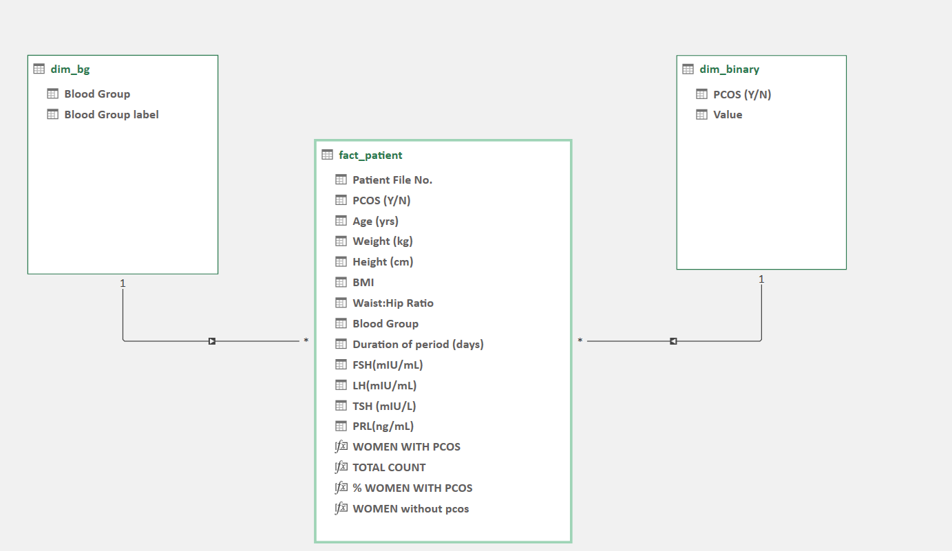
DATA MODELLING
The data was prepared for data modeling
A data model was created by linking appropriate columns from the dimension tables to the fact tables.
A one-to-many relationship was established.
Data modeling was performed using the star schema technique
DATA MODEL DIAGRAM

Slide 7
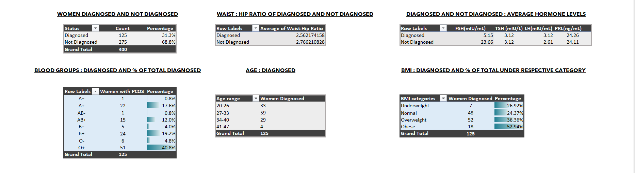
PIVOT TABLES AND CONDITIONAL FORMATTING
Pivot tables were inserted. Relevant columns and rows were pulled into respective pivot tables
Conditional formatting was applied to distinguish between different percentages and to understand the severity better

Slide 8
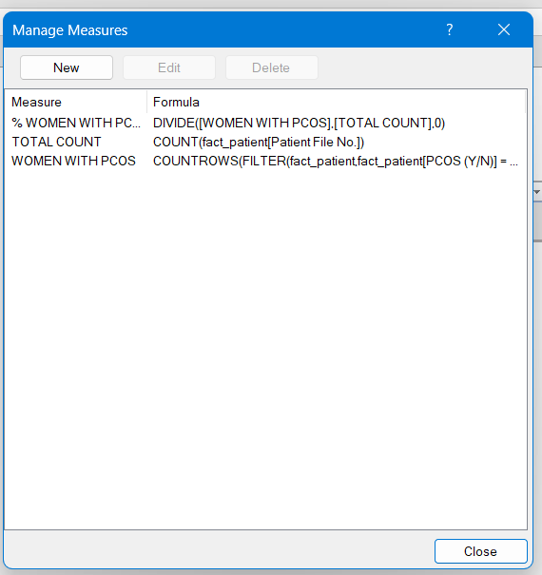


DAX(Data Analysis Expression) MEASURES
ƒx
Missing columns were identified, hence
DAX measures were used to create the required formulas.
These measures were then incorporated into the pivot table, enabling the establishment of relationships.

Slide 9
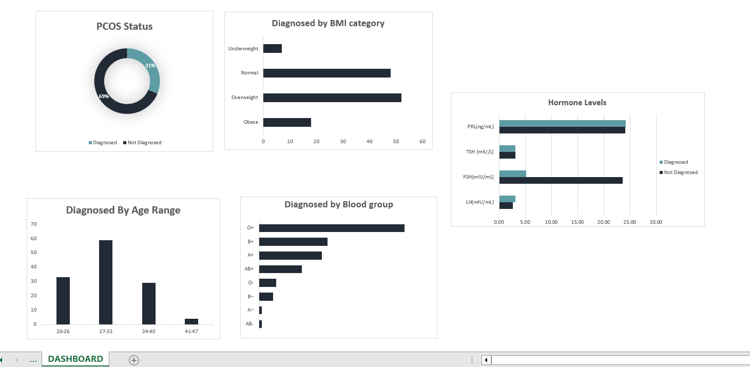
DASHBOARD
This dashboard summarizes PCOS diagnosis trends across key factors:
Diagnosis status
BMI, Age, and Blood group distributions
Hormone level comparisons
These insights highlight key patterns and potential risk indicators.

Slide 10
TO CONCLUDE…
KEY CONCLUSIONS
Higher BMI (specifically women under the overweight category) is linked to increased PCOS cases.
Most diagnoses occur in the 20–34 age range.
B+ and O+ blood groups show slightly higher occurrence.
PCOS patients have higher LH and PRL hormone levels in comparison to non-diagnosed women.
DAX measures and dashboards helped highlight these patterns effectively.

Slide 11
Thank You

Slide 12
DATASET SOURCE
https://www.kaggle.com/datasets/prasoonkottarathil/polycystic-ovary-syndrome-pcos?select=PCOS_data_without_infertility.xlsx

